Slide 1
for LINC Administrators

Slide 2
Presentation Outline
Project Overview
LINC Courseware
Learning Management System
PD/ Training
Technology standards
Manuals / Summary
Survey

Slide 3
Computer-Assisted Language Learning
Transition in CALL from
  Workstation/lab-based
  Independent
  Behaviourist
To
  Web-based
  More collaborative
  Constructivist

Slide 4
CIC –The Modernized Approach (2009)
The modernized approach is an outcome based approach, which aims at supporting newcomers by providing:
  “language training so they have the language/ skills to function in Canada”
CIC - Implementation of the Modernized Approach
Fall 2009

Slide 5
Digital Literacy
“The web has changed the way we live, work, learn – and even how we socialize with one another. It should therefore come as no surprise that digital literacy is now considered a basic skill for newcomers who want to succeed in the Canadian job market.”
New tools help teachers help newcomers
cross the digital divide
CIC e-News (March, 2011)

Slide 6
LearnIT2Teach Project
Jan 2010 – Mar 2013
Blended learning approach
Utilizes various web technologies for
  Language learning
  Teacher training
Building a learning community

Slide 7
Project Components
Key
Components
LINC
Courseware
Teacher
Training
Learning
Object
Repository
Web Portal

Slide 8
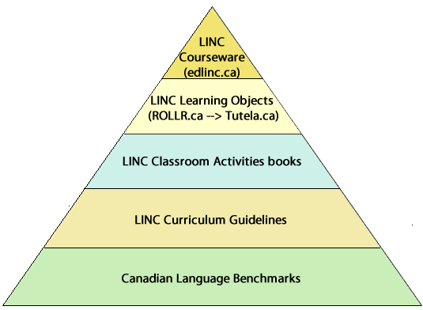
Courseware: A Solid Foundation

Slide 9
LINC Courseware
Blended mode
Complements Classroom Activities books
Plug and play
Collaborative
Self-correcting, self-pacing
LINC levels 3-7 and LINC 2*
Provides activities to practice:
  Reading, Writing, Listening, Speaking*

Slide 10
Benefits of the Courseware
Ready-made
Relevant, safe, reliable content
Reinforces best practices
Digital citizenship
Learning styles
Flexible
Anytime/anywhere access
Re-usable

Slide 11
What is an LMS?

Slide 12
Pedagogical Benefits of an LMS
Structured online learning
Better communication and interaction:
  learner-instructor
  learner-learner
  learner-content
Creates an additional learning environment
  place
  time
Motivation
Student tracking

Slide 13
Administrative Benefits: LMS
Open source = sustainability
Efficiency
  Resource sharing
  Standardization
Flexible delivery
Communication features
Branding
Accountability/ reporting

Slide 14
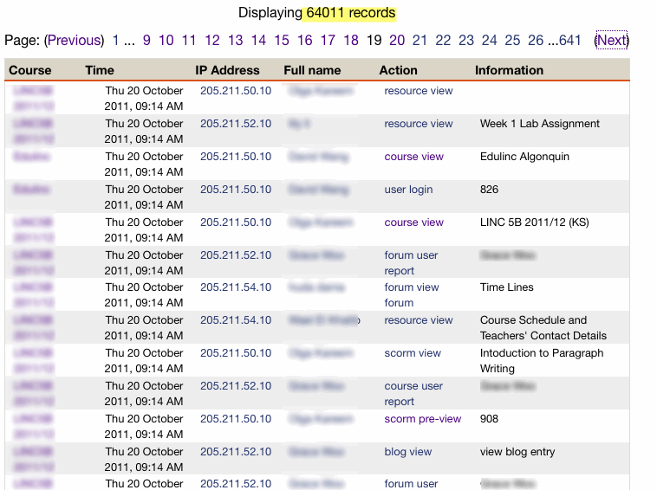
Administrative Benefits: LMS Reports

Slide 15
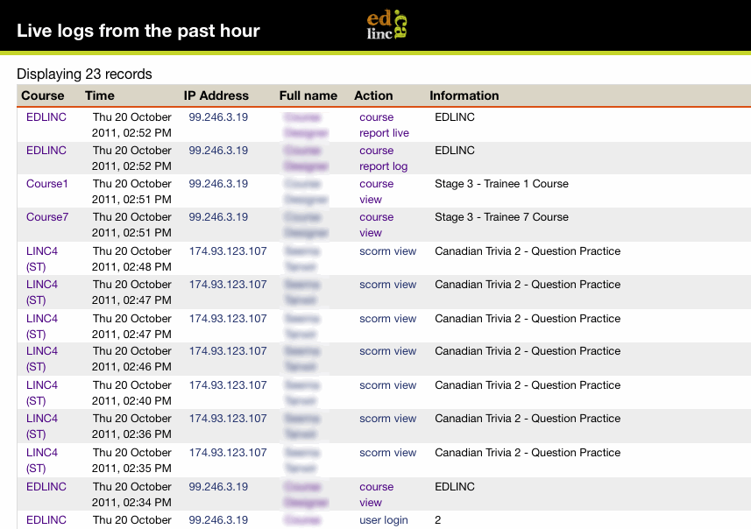
Administrative Benefits: LMS Reports

Slide 16
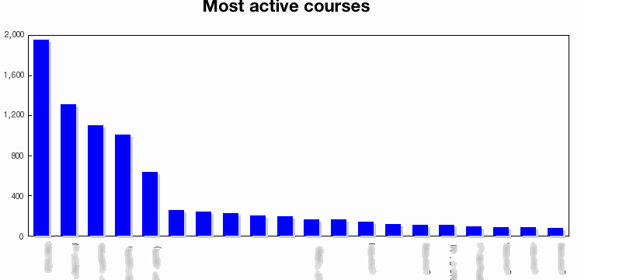
Administrative Benefits: LMS Reports

Slide 17
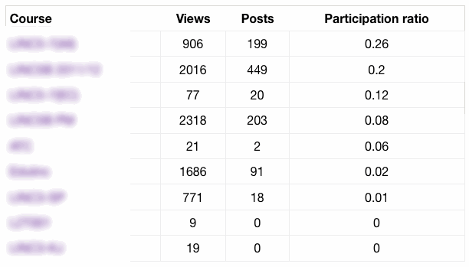
Administrative Benefits: LMS Reports

Slide 18
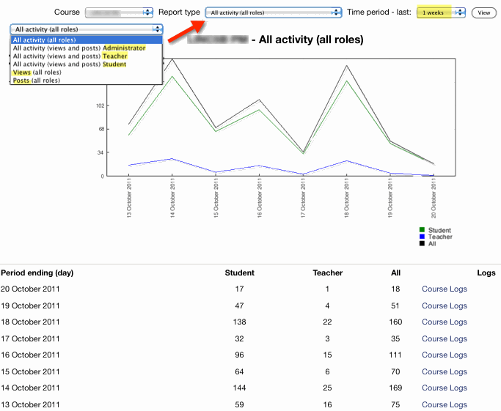
Administrative Benefits: LMS Reports

Slide 19
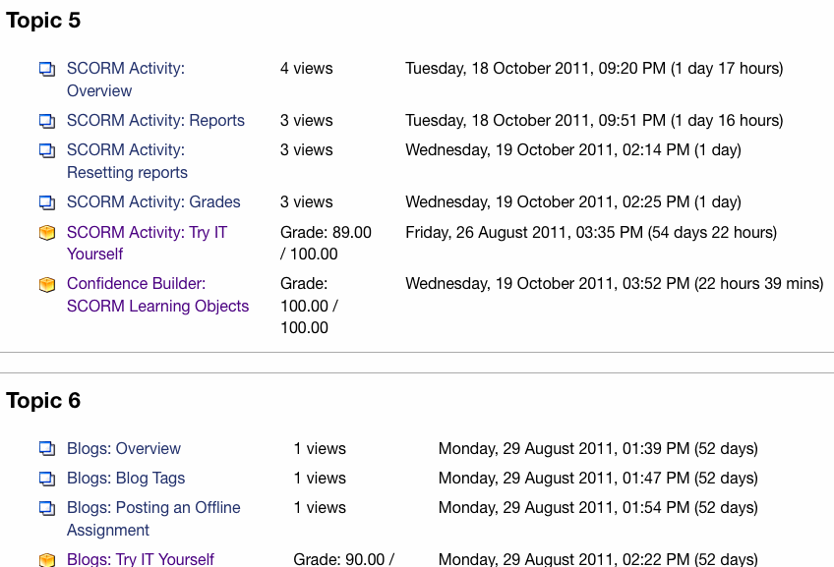
Administrative Benefits: LMS Reports

Slide 20
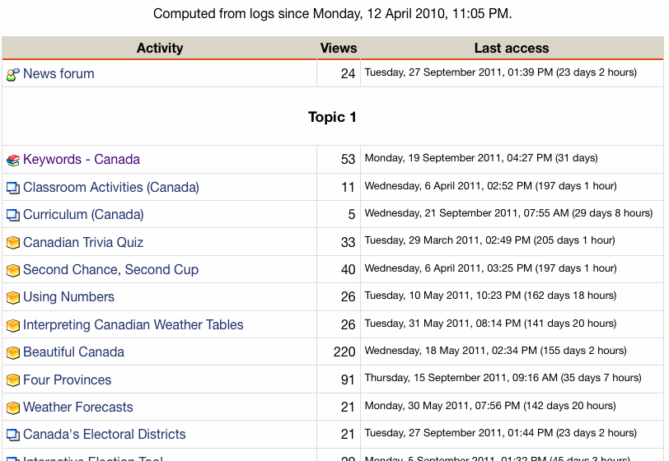
Administrative Benefits: LMS Reports

Slide 21
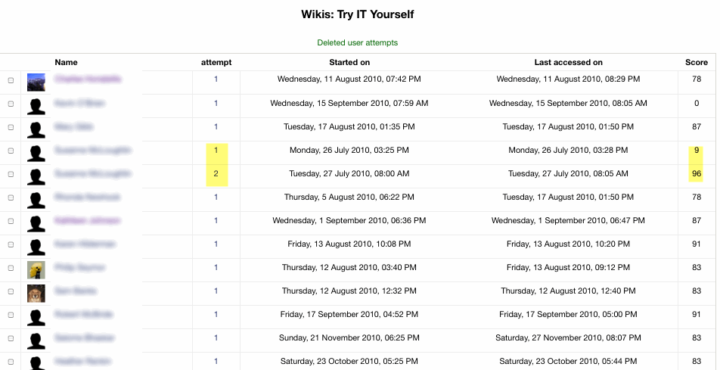
Administrative Benefits: LMS Reports

Slide 22
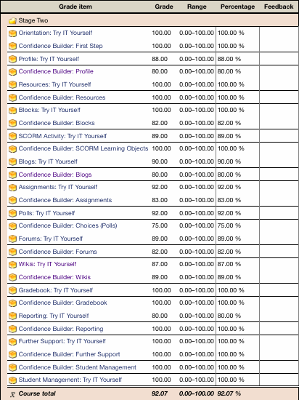
Administrative Benefits: LMS Reports

Slide 23
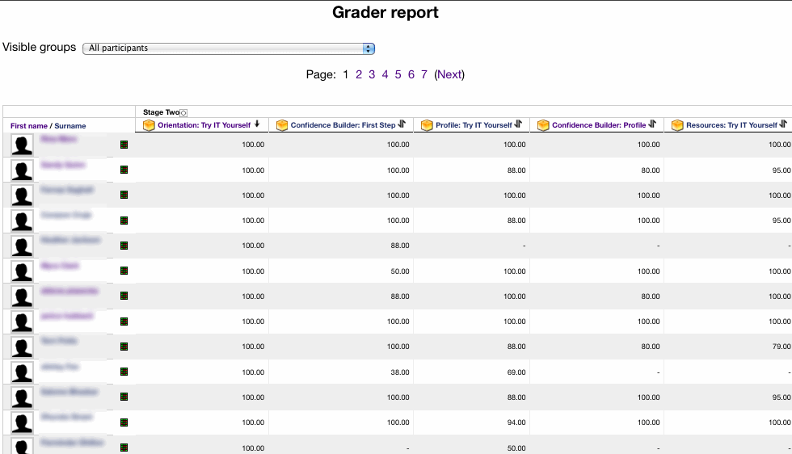
Administrative Benefits: LMS Reports

Slide 24
Challenges for LINC Administrators
Comprehending technology based language learning tools
Determining required tools
Upgrades to facilities/software
Local server option
Finding resources
Teacher buy-in
Supporting professional development

Slide 25
III. Teacher Training Overview
Stage | Role | Delivery
1 | student | blended
2 | non editing teacher | online
3 | editing teacher | online
4 | E-content developer * TESL Ontario Post-TESL Certificate Accreditation | online

Slide 26
Benefits of Teacher Training
Enables access to courseware
CIC-sponsored (free)
Learn new skills
TESL Ontario PTCT accreditation
Contact with larger professional group (outside of the centre)
Possible increased motivation?
Empower towards innovation
Become developers

Slide 27
Challenges of Teacher Training
Teacher
Time
Technical support
Motivation (increased decreased)
Administrator
Compensation
Scheduling
Locating trainer, facility
Setting objectives

Slide 28
Technology Standards
ISTE, UNESCO, TESOL
Standards for success
  Learner
  Teacher
  Administrator
Performance Indicators
Essential Conditions

Slide 29
Performance Indicators
Visionary Leadership
Digital-Age Learning Culture
Excellence in Professional Practice
Systemic Improvement
Digital Citizenship

Slide 30
Essential conditions
Leveraging technology for learning
Ongoing professional learning (4 stages, mentorships and just-in time support)
Equitable access (free, web based)
Engaged communities (Twitter, Facebook, Forums)
External Support Tutela, edlinc, LearnIt2teach, CLBAs Settlement.org wiki)

Slide 31
Project Update
Stage 1: 636 instructors finished
Stage 2: 184 teacher logged in
Stage 2: 85 logged in in last 60 days
Stage 3: 71 enrolled, most progressing
Stage 4: no takers
Courseware: approx. 350 users, mostly student

Slide 32
What’s Ahead
Stage 4 PTCT
Online speaking activities
Transition to newer LMS
More LINC 5-7 resources
Training manual/ workshop for LINC Administrators
  Survey (today)
  Consultation (ongoing)

Slide 33
Conclusion
Support point online:
www.learnit2teach.ca/
Print Resource
Identify a champion
Survey
  Drop off hard copy at table
  Complete it online at:
  https://www.surveymonkey.com/s/DFY226G

